Slide 1
Machine Reading, Question Answering & Dialog AMMI – Deep NLP – Part III
Angela Fan, Louis Martin, Antoine Bordes
Facebook AI Research (Paris)
March 18-22, 2019

Slide 2

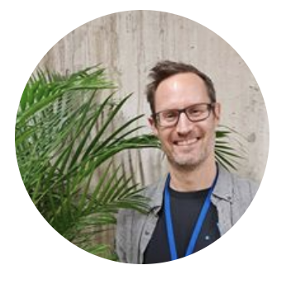
Who are we?
Angela angelafan@fb.com
PhD Student FAIR Paris
Louis
louismartin@fb.com
PhD Student FAIR Paris
Antoine
abordes@fb.com
Director FAIR Paris
+ Help from Sebastian Riedel (Research Scientist FAIR London)

Slide 3
This Class:
Machine Reading with deep learning
Open-domain Question answering
Deep learning for dialogue

Slide 4
Quick schedule
Monday: 2pm lecture “Machine Reading” [Antoine]
Tuesday: 9am labs “Machine Reading” [Angela/Louis] + office hours 11m [All]
Wednesday: 2pm lecture “Question Answering” [Antoine] + office hours 4pm [All]
Thursday: 9am lecture “Dialog” [Antoine] + 11:15am exam [All]
Friday: 2pm labs “Dialog” [Angela/louis]

Slide 5
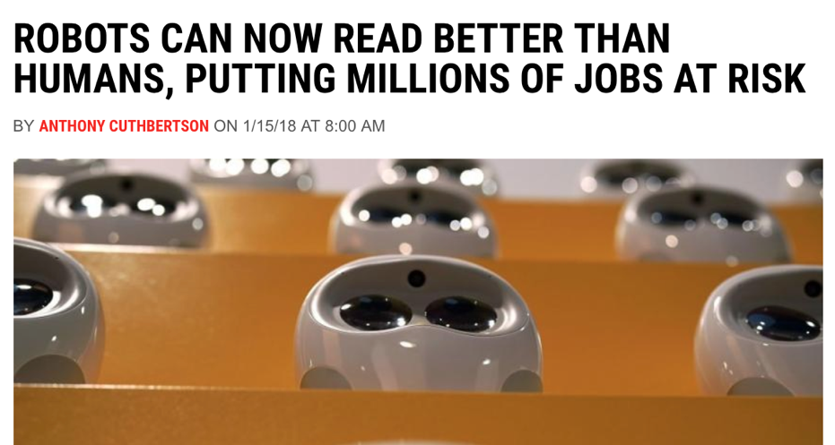
Machine Reading
Notes:
What could this mean?
What should this mean?

Slide 6
Machine Reading
ROBOTS CAN NOW PATTERN MATCH ON A BENCHMARK DATASET BETTER THAN HUMANS
Notes:
What could this mean?
What should this mean?

Slide 7
Machine Reading
BUT THERE HAS BEEN A LOT OF PROGRESS AND MACHINE READING RESEARCH ACTIVITY HAS SKYROCKETED
Notes:
But there has been a lot of process and activity in this area has sky rocketed

Slide 8
Main (big) motivation
Machines processing text to satisfy an information need is long standing goal of AI

Slide 9
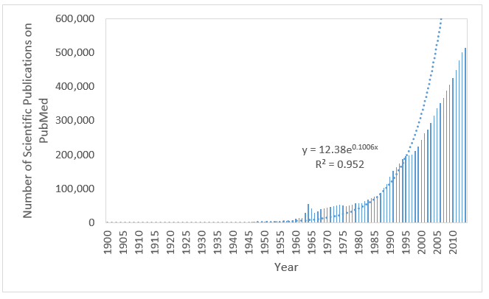


Motivation 1: Information Overload
[Information Need]
uses for

Slide 10
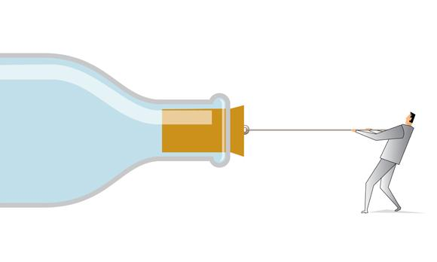
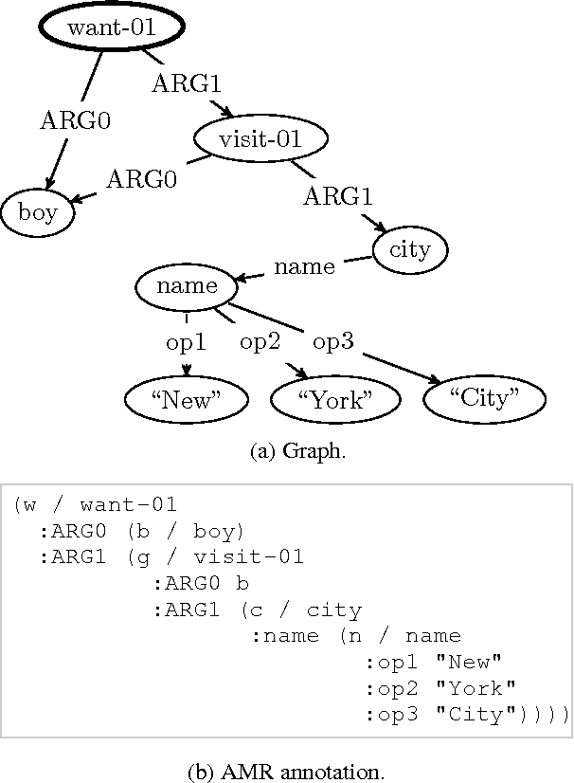
Motivation 2: The Knowledge Acquisition Bottleneck
“The problem of knowledge acquisition is the critical bottleneck problem in artificial intelligence.” E. A. Feigenbaum 1984
[Knowledge]
[Meaning]
[Information Need]
uses for

Slide 11
Applications: Question Answering
In January 1880, two of Tesla's uncles put together enough money to help him leave Gospić for Prague where he was to study. Unfortunately, he arrived too late to enrol at Charles-Ferdinand University; he never studied Greek, a required subject; and he was illiterate in Czech, another required subject. Tesla did, however, attend lectures at the university, although, as an auditor, he did not receive grades for the courses.
What city did Tesla move to in 1880?
?
Prague
[Text]
[Meaning]
[Information Need]

Slide 12
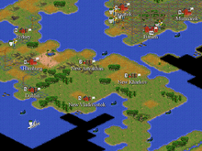
Applications: Helping Agents to learn Faster
Branavan et al., JMLR’12
The natural resources available where a population settles affects its ability to produce food and goods. Build your city on a plains or grassland square with a river running through it if possible.
?
[Text]
[Meaning]
[Information Need]

Slide 13
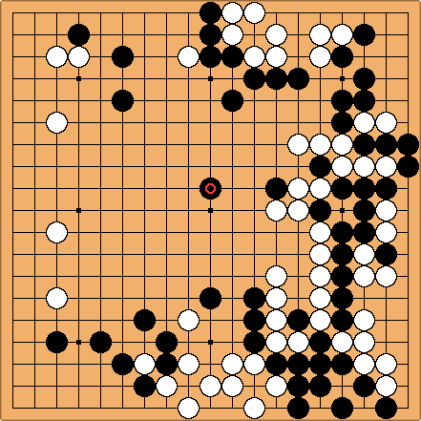
Applications: Helping Agents to learn Faster
A fundamental Go strategy involves keeping stones connected. Connecting a group with one eye to another one-eyed group makes them live together. Connecting individual stones into a single group results in an increase of liberties ...
?
[Text]
[Meaning]
[Information Need]

Slide 14
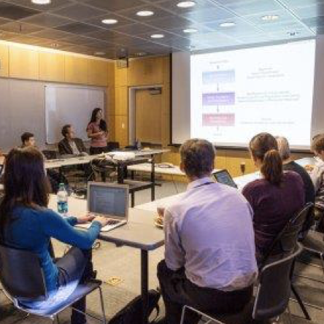
Applications: Support a Molecular Tumor Board
Poon et al., ACL’17
The deletion mutation on exon-19 of EGFR gene was present in 16
patients, while the L858E point mutation on exon-21 was noted in 10.
All patients were treated with gefitinib and showed a partial response.
?
?
drug-drug?
[Text]
[Meaning]
[Information Need]

Slide 15
Machine Reading
Machines understanding text?

Slide 16
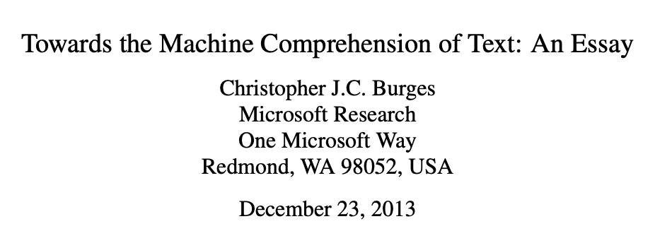
Machine Reading
“A machine comprehends a passage of text if, for any question regarding that text that can be answered correctly by a majority of native speakers, that machine can provide a string which those speakers would agree both answers that question, and does not contain information irrelevant to that question.”
Notes:
Connect machine reading with human comprehension

Slide 17
Machine Reading
A machine processes a passage of text to satisfy an information need (usually answer a question on it)

Slide 18
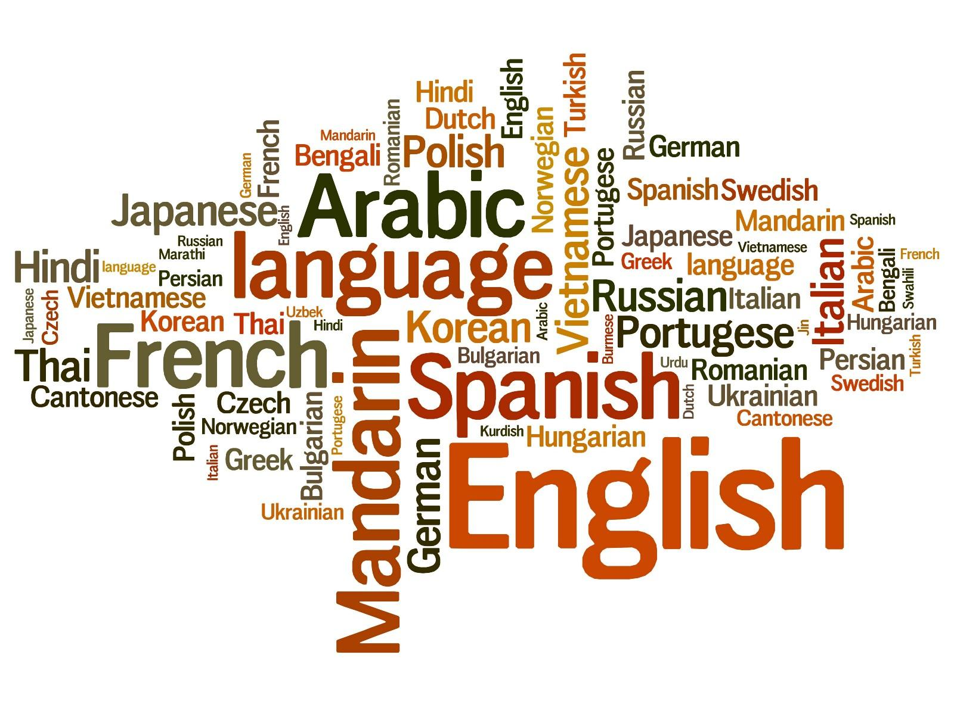
Machine Reading
In January 1880, two of Tesla's uncles put together enough money to help him leave Gospić for Prague where he was to study. Unfortunately, he arrived too late to enrol at Charles-Ferdinand University; he never studied Greek, a required subject; and he was illiterate in Czech, another required subject. Tesla did, however, attend lectures at the university, although, as an auditor, he did not receive grades for the courses.
[Passage of Text]
[Information Need]
uses for

Slide 19
Machine Reading
In January 1880, two of Tesla's uncles put together enough money to help him leave Gospić for Prague where he was to study. Unfortunately, he arrived too late to enrol at Charles-Ferdinand University; he never studied Greek, a required subject; and he was illiterate in Czech, another required subject. Tesla did, however, attend lectures at the university, although, as an auditor, he did not receive grades for the courses.
?
[Passage of Text]
[Meaning]
[Information Need]
converts into
uses for

Slide 20
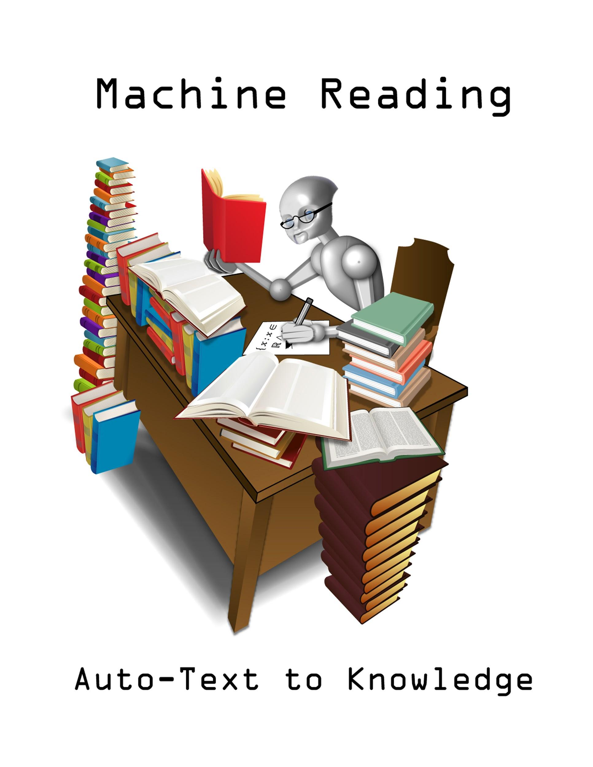
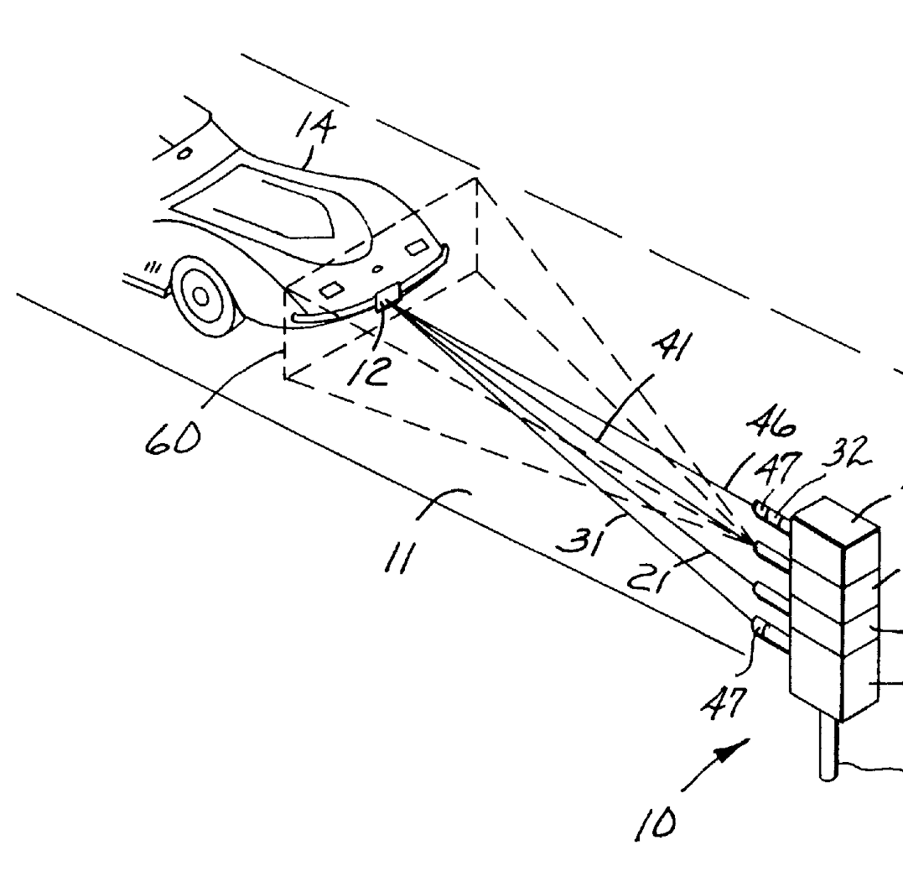
Timeline of Machine Reading
Something else entirely!
Text to Meaning Representations
End-to-End Machine Reading
?
?
?
before 2006
2006-2014
since 2014
Etzioni et. all, DARPA etc.

Slide 21
Today we cover:
?
End-to-End Machine Reading
?
since 2014

Slide 22
Machine Reading
In January 1880, two of Tesla's uncles put together enough money to help him leave Gospić for Prague where he was to study. Unfortunately, he arrived too late to enrol at Charles-Ferdinand University; he never studied Greek, a required subject; and he was illiterate in Czech, another required subject. Tesla did, however, attend lectures at the university, although, as an auditor, he did not receive grades for the courses.
?
[Passage of Text]
[Meaning]
[Information Need]
converts into
uses for

Slide 23
Symbolic Approaches (until 2014 or so)
In January 1880, two of Tesla's uncles put together enough money to help him leave Gospić for Prague where he was to study. Unfortunately, he arrived too late to enrol at Charles-Ferdinand University; he never studied Greek, a required subject; and he was illiterate in Czech, another required subject. Tesla did, however, attend lectures at the university, although, as an auditor, he did not receive grades for the courses.
?
[Passage of Text]
[Meaning]
[Information Need]
converts into
uses for

Slide 24
End-to-End Approaches (since 2014 or so)
In January 1880, two of Tesla's uncles put together enough money to help him leave Gospić for Prague where he was to study. Unfortunately, he arrived too late to enrol at Charles-Ferdinand University; he never studied Greek, a required subject; and he was illiterate in Czech, another required subject. Tesla did, however, attend lectures at the university, although, as an auditor, he did not receive grades for the courses.
[Passage of Text]
[Meaning]
[Information Need]

Slide 25
What do we need from a representation?
Fast Retrieval
Generalization
Broad Coverage
Easy Engineering
Support Reasoning
Small Memory Footprint
In January 1880, two of Tesla's uncles put together enough money to help him leave Gospić for Prague where he was to study. Unfortunately, he arrived too late to enrol at Charles-Ferdinand University; he never studied Greek, a required subject; and he was illiterate in Czech, another required subject. Tesla did, however, attend lectures at the university, although, as an auditor, he did not receive grades for the courses.
[Passage of Text]
[Meaning]

Slide 26
What are the core challenges?
In January 1880, two of Tesla's uncles put together enough money to help him leave Gospić for Prague where he was to study. Unfortunately, he arrived too late to enrol at Charles-Ferdinand University; he never studied Greek, a required subject; and he was illiterate in Czech, another required subject. Tesla did, however, attend lectures at the university, although, as an auditor, he did not receive grades for the courses.
Ambiguity
Variation
Coreference
Common Sense
Scale
...
[Passage of Text]
[Meaning]

Slide 27
“Traditional” NLP
In January 1880, two of Tesla's uncles put together enough money to help him leave Gospić for Prague where he was to study. Unfortunately, he arrived too late to enrol at Charles-Ferdinand University; he never studied Greek, a required subject; and he was illiterate in Czech, another required subject. Tesla did, however, attend lectures at the university, although, as an auditor, he did not receive grades for the courses.
Tokenization
Preprocessing
Segmentation
Feature 1 → Value 1
Feature 2 → Value 2
Feature 3 → Value 3
...
Feature N → Value N
POS Tagging
Classifier
Linear
SVM
Random Forests
PGMs: CRFs, ...
Syntactic Analysis
Syntactic Parsing
N could easily be in the millions!
Feature Engineering & Domain Expertise
NER Tagging
Semantic Analysis
Relation Extraction
Error propagation, but no back-propagation to correct that
Notes:
Relies on rather complicated pipelines that include various linguistic pre-processing steps. Each is prone to errors which will propagate through the pipeline.
Requires intensive feature engineering. Typical feature spaces are very high dimensional (several millions), mostly due to the large vocabularies we are dealing with.
Simple ML models (e.g. logistic regression)
→ Problems: complicated -> high entry barrier, error propagation, over-fitting

Slide 28
End-to-end System
only input/output given
[...] Precipitation forms as smaller droplets coalesce via collision with other rain drops or ice crystals within a cloud. Short, intense periods of rain in scattered locations are called “showers”.
?
Where do water droplets collide with ice crystals to form precipitation?
a
within a cloud
[Passage of Text]
[Meaning]
[Information Need]

Slide 29
Machine Reading / Data

Slide 30
Limits of Big Model + Big Data
End-to-end systems need a lot of cleaned data!
Getting real conditions large-scale data is difficult:
Real large-scale data is complex, noisy, unlabeled…
Interpretation of success or failure is complex
Complicates the design of innovative learning systems
Some recent process with large amounts of unlabeled data [see Wednesday!]

Slide 31
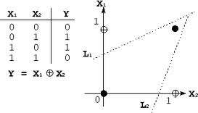
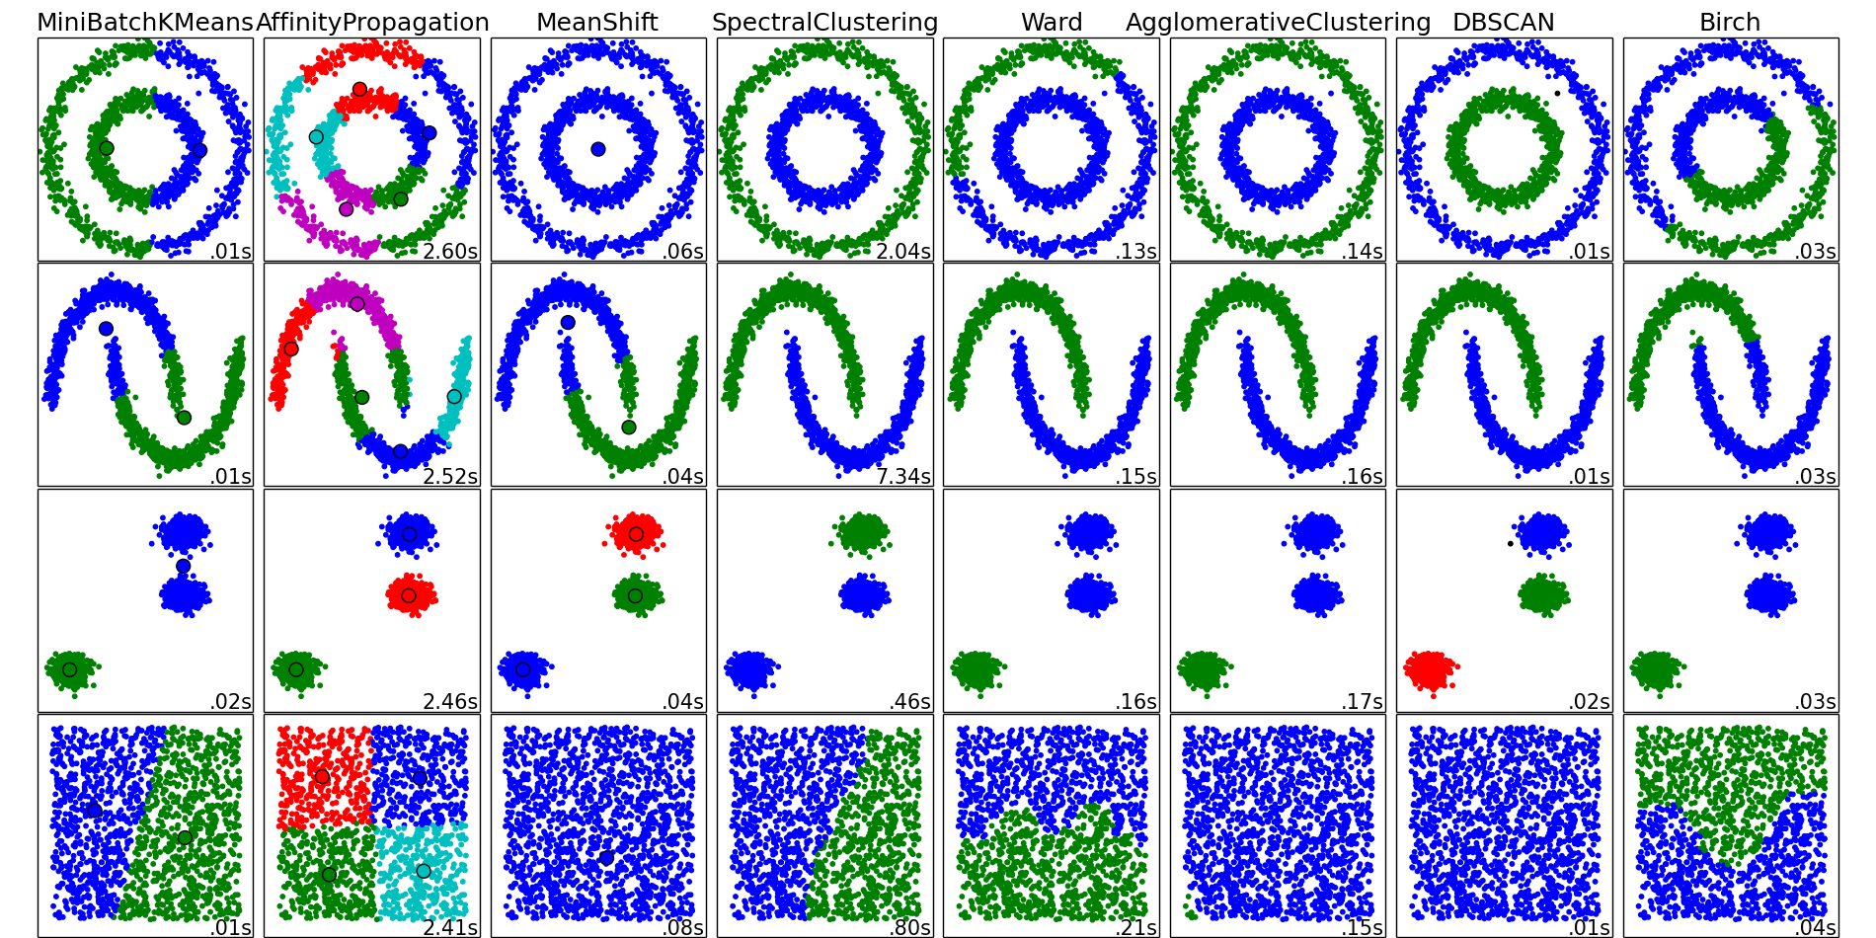

A long history of artificial problems in ML
XOR (neural networks)
Two moons and friends (clustering)
Many in the UCI repository
(regression, classification)
Toy/artificial problems in ML: crucial for demonstrating and assessing the usefulness/efficiency of new algorithms

Slide 32
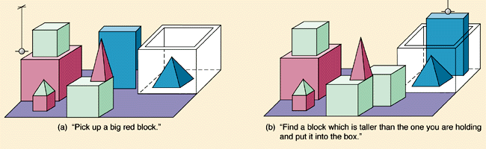
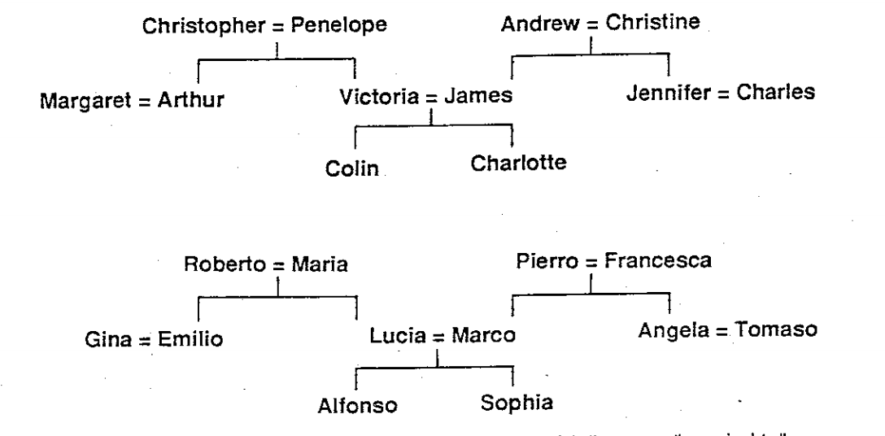
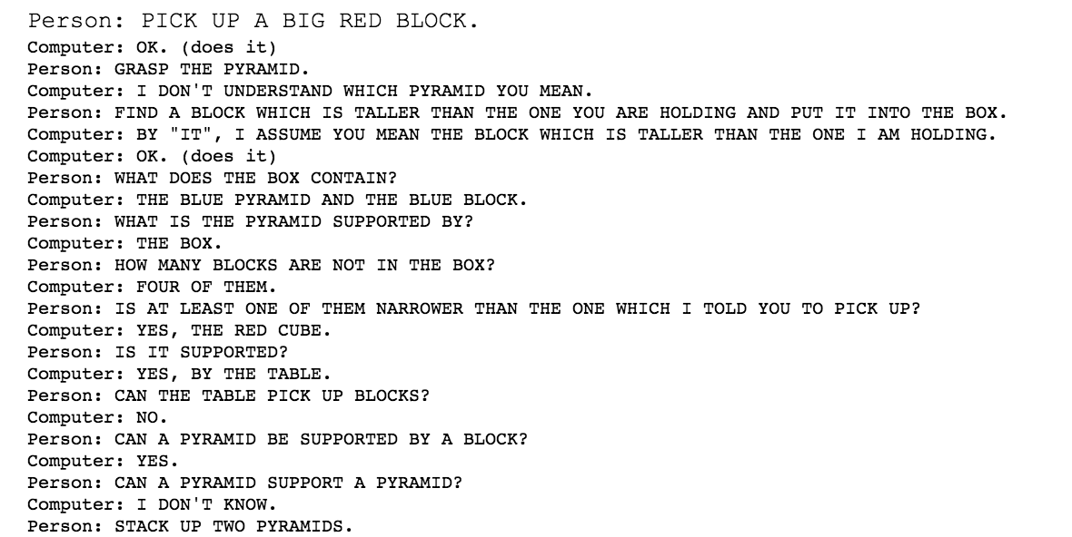
And in early AI too
Block Worlds (Winograd 1971)
Family trees (Hinton CogSci’86)

Slide 33
bAbI Tasks
Weston et al., ICLR’15
20 artificial tasks for machine reading
Answer has to be picked among a set of candidates
Each task checks one skill that a reasoning system should have.
Goal: develop systems able to solve all tasks with no task specific engineering.
A postulate is that performing well on all of them is a pre-requisite for any system aiming at understanding language and able to reason.

Slide 34
Simulation commands
go <place>
get <object>
get <object1> from <object2>
put <object1> in/on <object2>
give <object> to <person>
drop <object>
look
inventory
examine <object>
+ 2 commands for "gods'' (superusers):
create <object>
set <obj1> <relation> <obj2>

Slide 35
Example
Simple grammar
Command format
Story
jason go kitchen
jason get milk
jason go office
jason drop milk
jason go bathroom
where is milk ? A: office
where is jason? A: bathroom
Jason went to the kitchen.
Jason picked up the milk.
Jason travelled to the office.
Jason left the milk there.
Jason went to the bathroom.
Where is the milk now? A: office
Where is Jason? A: bathroom

Slide 36
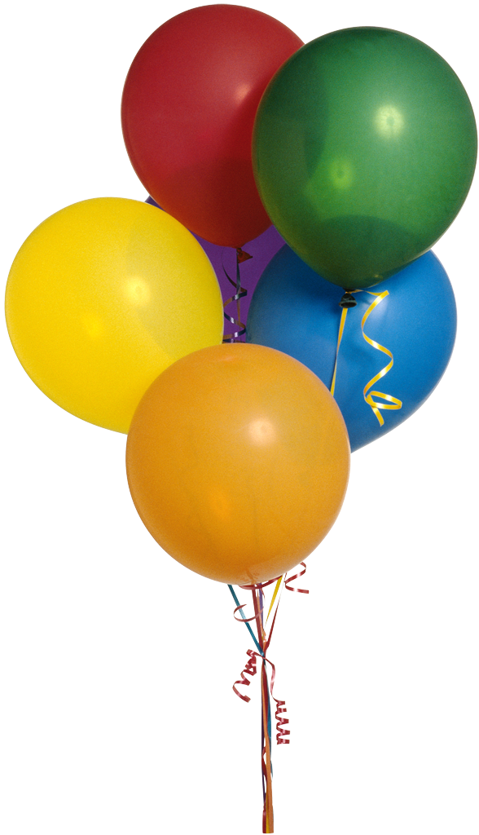
(T1) Single supporting fact “where is actor”
A single supporting fact, previously given, provides the answer.
Simplest case of this: asking for the location of a person.
John is in the playground.
Bob is in the office.
Where is John? A:playground
SUPPORTING FACT

Slide 37
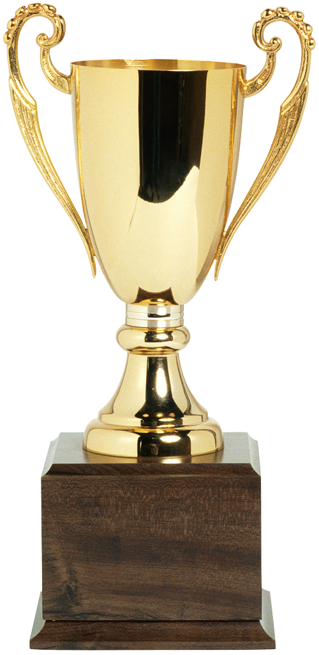
(T2) Two supporting facts “where is actor+object”
Harder task: two supporting statements have to be chained to answer
To answer the first question Where is the football? both John picked up the football and John is in the playground are supporting facts
John is in the playground.
Bob is in the office.
John picked up the football.
Bob went to the kitchen.
Where is the football? A:playground
Where was Bob before the kitchen? A:office
SUPPORTING FACT
SUPPORTING FACT

Slide 38
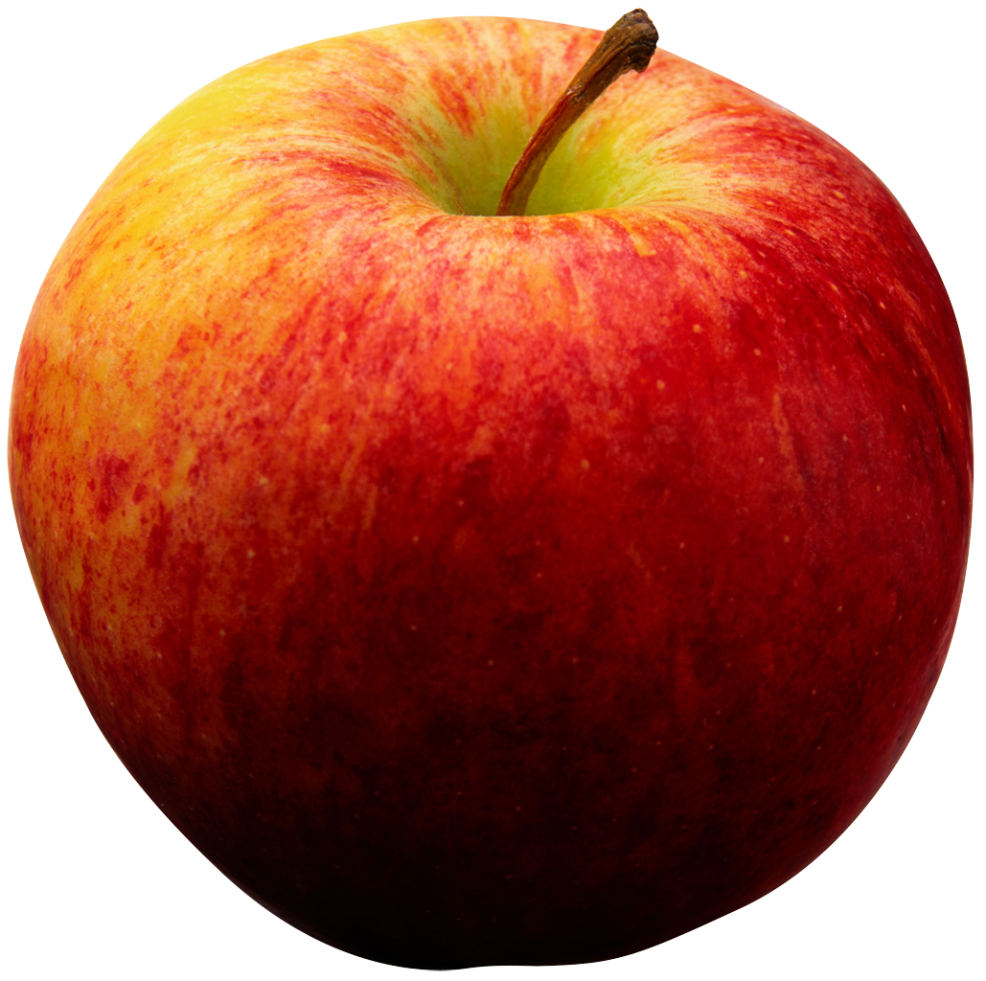
(T3) Three supporting facts
Similarly, one can make a task with three supporting facts:
The first three statements are all required to answer this.
John picked up the apple.
John went to the office.
John went to the kitchen.
John dropped the apple.
Where was the apple before the kitchen? A:office

Slide 39
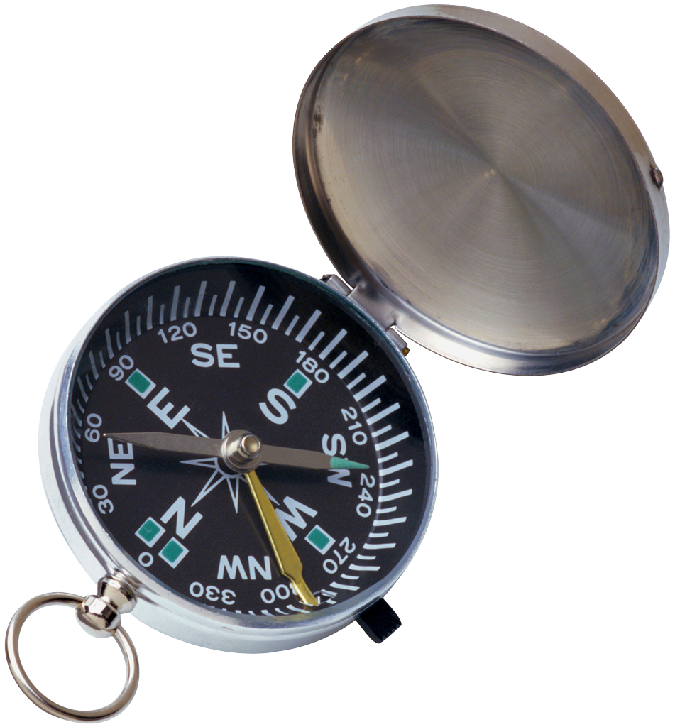
(T4) Two argument relations: subj vs. obj.
To answer questions the ability to differentiate and recognize subjects and objects is crucial
Extreme case - sentences feature re-ordered words:
The two questions above have exactly the same words, but in a different order, and different answers.
So a bag-of-words will not work.
The office is north of the bedroom.
The bedroom is north of the bathroom.
What is north of the bedroom? A:office
What is the bedroom north of? A:bathroom

Slide 40
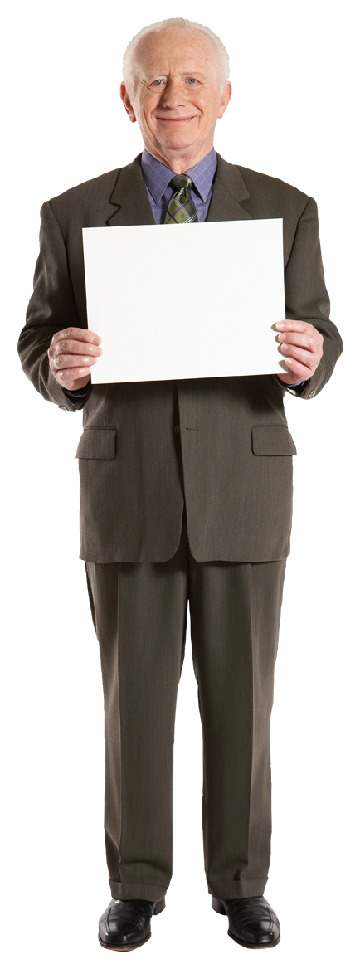

(T6) Yes/No questions
This task tests, in the simplest case possible (with a single supporting fact) the ability of a model to answer true/false type questions:
John is in the playground.
Daniel picks up the milk.
Is John in the classroom? A:no
Does Daniel have the milk? A:yes
YES
NO

Slide 41
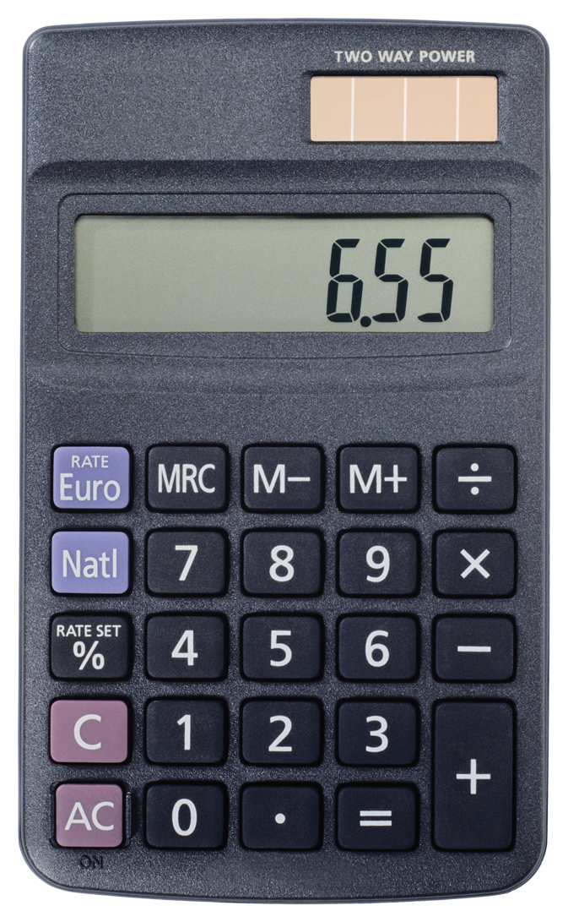
(T7) Counting
This task tests the ability of the QA system to perform simple counting operations, by asking about the number of objects with a certain property:
Daniel picked up the football.
Daniel dropped the football.
Daniel got the milk.
Daniel took the apple.
How many objects is Daniel holding? A:two

Slide 42
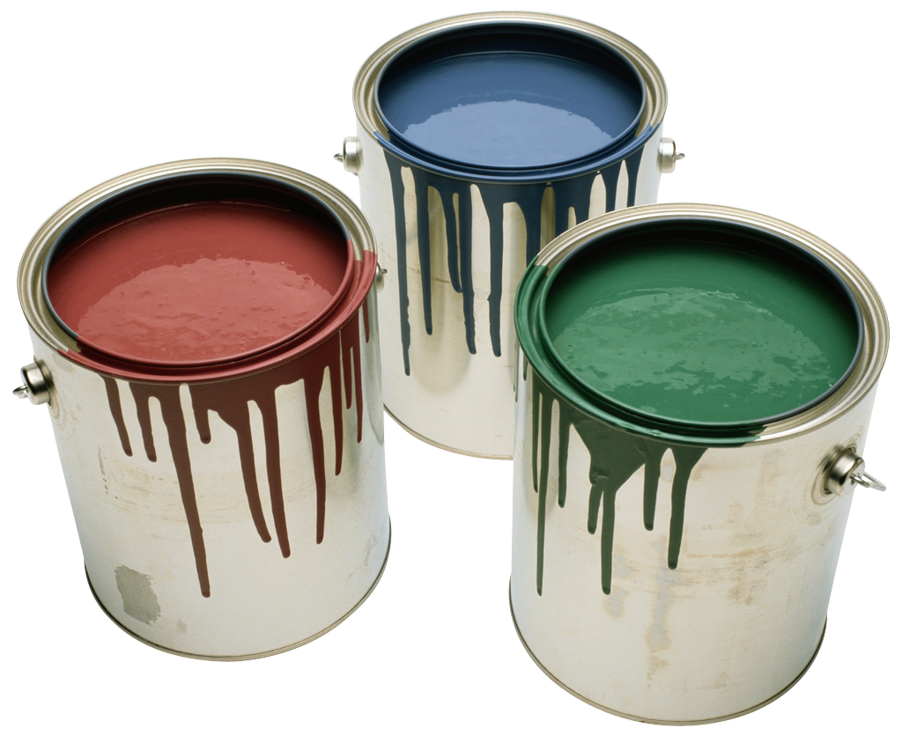
(T17) Positional reasoning
This task tests spatial reasoning:
Close from block worlds, with no vision input.
The Yes/No task (6) is a prerequisite.
The triangle is to the right of the blue square.
The red square is on top of the blue square.
The red sphere is to the right of the blue square.
Is the red sphere to the right of the blue square? A:yes
Is the red square to the left of the triangle? A:yes

Slide 43
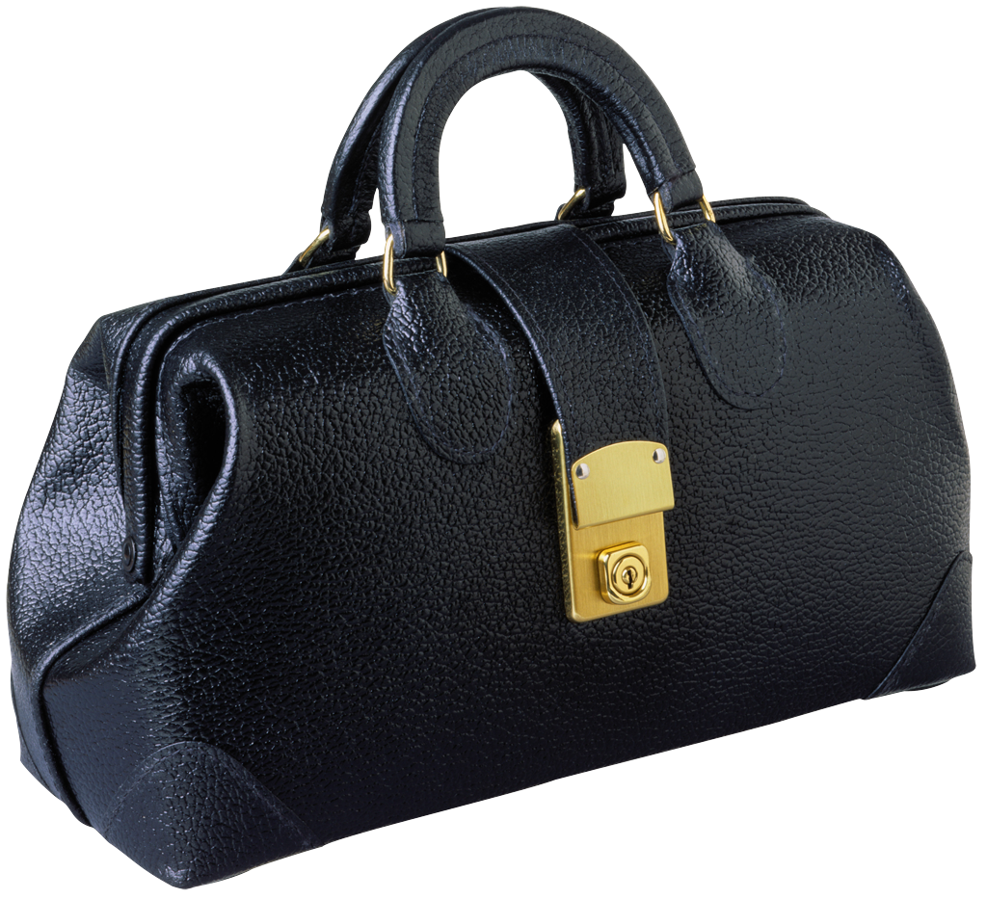
(T18) Reasoning about size
This task requires reasoning about relative size of objects :
Inspired by the commonsense reasoning examples of the Winograd schema challenge
Tasks 3 (three supporting facts) and 6 (Yes/No) are prerequisites.
The football fits in the suitcase.
The suitcase fits in the cupboard.
The box of chocolates is smaller than the football.
Will the box of chocolates fit in the suitcase? A:yes

Slide 44
Winograd Schemas
Definition: A Winograd schema is a pair of sentences that differ in only one or two words and that contain an ambiguity that is resolved in opposite ways in the two sentences and requires the use of world knowledge and reasoning for its resolution.
Levesque, AAAI’11
it = trophy or suitcase ?
More schemas here: https://cs.nyu.edu/faculty/davise/papers/WinogradSchemas/WSCollection.html
The trophy would not fit in the brown suitcase because it was too big.
The trophy would not fit in the brown suitcase because it was too small.

Slide 45
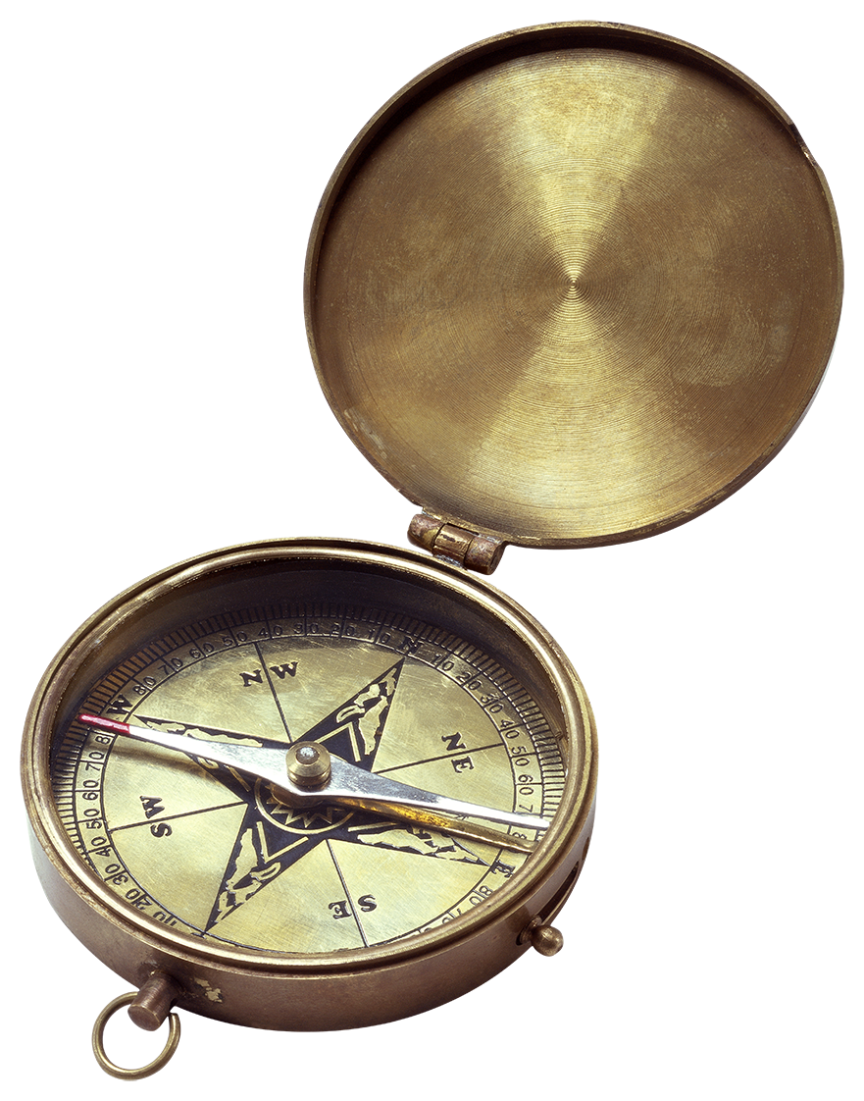
(T19) Path finding
In this task the goal is to find the path between locations:
This task is difficult because it effectively involves search.
The kitchen is north of the hallway.
The den is east of the hallway.
How do you go from den to kitchen? A:west,north

Slide 46
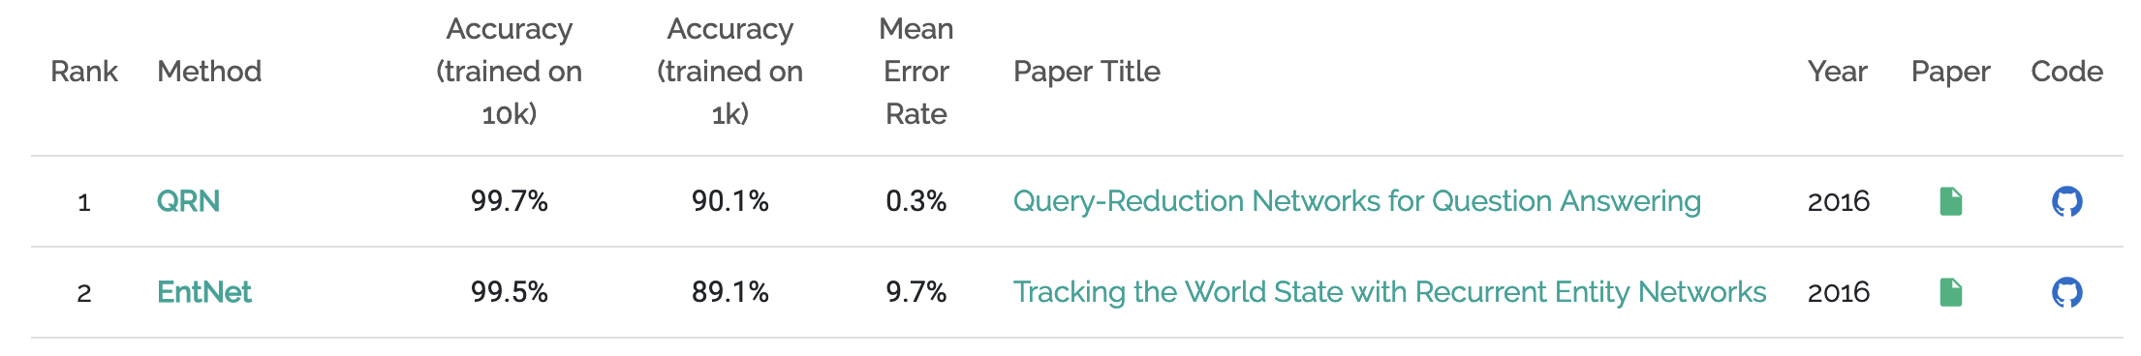
Dashboard
Training on 1k stories
Weak supervised
Fully supervised
TASK | N-grams | LSTMs | StructSVM + COREF + SRL | Attention model
T1. Single supporting fact | 36 | 50 | PASS | PASS
T2. Two supporting facts | 2 | 20 | 74 | PASS
T3. Three supporting facts | 7 | 20 | 17 | PASS
T4. Two arguments relations | 50 | 61 | PASS | PASS
T5. Three arguments relations | 20 | 70 | 83 | 84
T6. Yes/no questions | 49 | 48 | PASS | 49
T7. Counting | 52 | 49 | 69 | 73
T8. Sets | 40 | 45 | 70 | 87
T9. Simple negation | 62 | 64 | PASS | 62
T10. Indefinite knowledge | 45 | 44 | PASS | 50
T11. Basic coreference | 29 | 72 | PASS | PASS
T12. Conjunction | 9 | 74 | PASS | PASS
T13. Compound coreference | 26 | PASS | PASS | PASS
T14. Time reasoning | 19 | 27 | PASS | PASS
T15. Basic deduction | 20 | 21 | PASS | PASS
T16. Basic induction | 43 | 23 | 24 | PASS
T17. Positional reasoning | 46 | 51 | 61 | 48
T18. Size reasoning | 52 | 52 | 62 | 68
T19. Path finding | 0 | 8 | 49 | 4
T20. Agent’s motivation | 76 | 91 | PASS | PASS
Source: https://paperswithcode.com/sota/question-answering-babi

Slide 47
Artificial tasks for Machine Reading
Advantages:
Total control on the complexity of the tasks/reasoning
Clear interpretation of results
Small-ish scale so easy to prototype on them
Challenges:
How do we know that artificial data models the right problem?
By creating the tasks that we are solving, aren’t we fooling ourselves?
How transfer from artificial to real conditions?
Notes:
Discussion around these points with the students → this will be a question of the quiz

Slide 48
Other Machine Reading & QA Datasets
Dataset Name | Task Format | Supervision type | Total Size | Authors / Reference
TREC-QA | Query log, IR + free form | Human verification | 1,479 | Voorhees and Tice (2000)
QuizBowl | Trivia Question Answering | Expert Creation | 37,225 | Boyd-Graber et al (2012)
WebQuestions | NL question + KB | Google Search API & Human verification | 5,810 | Berant et al. (2013)
MCTest | Multiple Choice QA | crowdsourced | 2640 | Richardson et al. (2013)
CNN & Daily Mail | Cloze, Multiple Choice QA | Distant Supervision | 387,420 + 997,467 | Hermann et al. (2015)
WikiQA | Extractive QA/ sentence selection Â with Bing queries | crowdsourced | 3,047 | Yang et al. (2015)
bAbI | 20 complex reasoning tasks with controlled language | Automatically Generated | 20,000 | Weston et al. (2015)
SimpleQuestions | NL question + KB | KB + crowdsourced questions | 108,442 | Bordes et al (2015)
Children Book Test | Multiple Choice Cloze QA | Automatic (fill-the-blank) | 687,343 | Hill et al. (2016)
SQuAD (1.0 + 2.0) | Extractive QA | Crowdsourced | 107,702 | Rajpurkar et al (2016), Rajpurkar and Jia et al (2018)
ComplexQuestions | NL question + KB | Search API & Human verification | 2,100 | Bao et al. (2016)
MovieQA | Multiple choice QA, text & video. | crowdsourced | 14,944 | Tapawasi et al. (2016)
WhoDidWhat | Cloze, Multiple Choice QA | Distant Supervision | 205,978 | Onishi et al. (2016)
MS MARCO | Bing queries and NL answers | crowdsourced | 100,000 | Nguyen et al (2016)
Lambada | Cloze QA | Automatic (human verification) | 10,022 | Paperno et al. (2016)
WikiReading | KB query, NL text | Distant Supervision | 18.58M | Hewlett et al. (2016)
TriviaQA | Trivia Question Answering | Expert Creation + Distant Supervision | 662,659 | Joshi et al. (2017)
SciQ | Multiple choice QA | crowdsourced | 13,679 | Welbl et al. (2017)
RACE | Multiple choice Exam questions | Expert Creation | 97,687 | Lai et al. (2017)
NewsQA | Extractive QA | crowdsourced | 119,633 | Trischler et al. (2017)
AI2 Science Questions | Multiple Choice Science Exam QA | Expert Creation | 5,059 | Allen Institute for AI (2017 release)
SearchQA | Trivia questions + Search Engine Results | Expert Creation + distant supervision | 140,461 | Dunn et al. (2017)
QUASAR-S & QUASAR-T | Cloze & free-form trivia questions | Distant supervision | 37,362 + 43,013 | Dhingra et al. (2017)
Wikihop & Medhop | KB query, NL text, multiple Choice | Distant Supervision | 51,318+2,508 | Welbl et al. (2018)
NarrativeQA | free-form answer generation | crowdsourced | 46,765 | Kocisky et al. (2018)

Slide 49
Stanford Question Answering Dataset (SQuAD)
Rajpurkar et. al., EMNLP’16
Dataset size: 107,702 samples
Widely used benchmark dataset
Task: Extractive Question Answering
System has to predict the start and end position of the answer in the passage of text

Slide 50
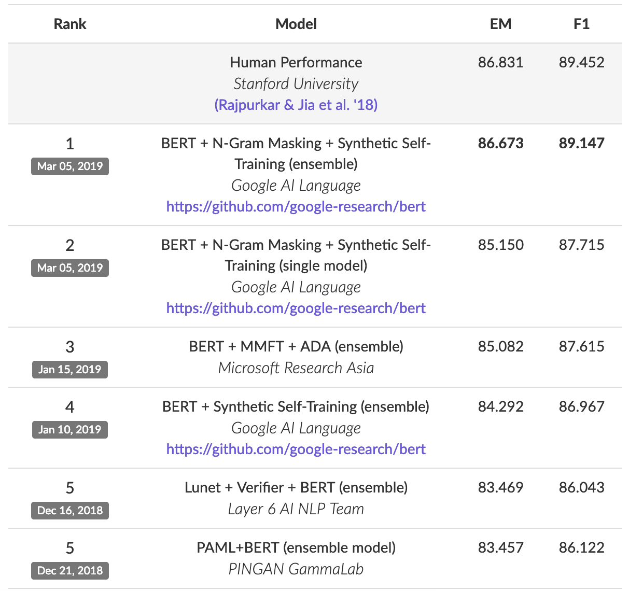
Stanford Question Answering Dataset (SQuAD)
Text Passage
Question + Answer
[...] Precipitation forms as smaller droplets coalesce via collision with other rain drops or ice crystals within a cloud. Short, intense periods of rain in scattered locations are called “showers”.
Where do water droplets collide with ice crystals to form precipitation?
Task: Given a paragraph and a question about it, predict the text span that states the correct answer.
within a cloud
Very popular leaderboard!
https://stanford-qa.com

Slide 51
Machine Reading / Models

Slide 52
End-to-end Machine Reading for Question Answering
fully differentiable model
[...] Precipitation forms as smaller droplets coalesce via collision with other rain drops or ice crystals within a cloud. Short, intense periods of rain in scattered locations are called “showers”.
?
Where do water droplets collide with ice crystals to form precipitation?
within a cloud
[Passage of Text]
[Meaning]
[Information Need]

Slide 53
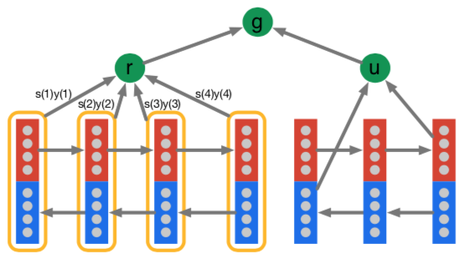
End-to-end Machine Reading for Question Answering
“Simple” Architecture
[...] Precipitation forms as smaller droplets coalesce via collision with other rain drops or ice crystals within a cloud. Short, intense periods of rain in scattered locations are called “showers”.
?
Where do water droplets collide with ice crystals to form precipitation?
within a cloud
Hermann et al., 2015
[Passage of Text]
[Meaning]
[Information Need]
Notes:
This example architecture is in fact the current state-of-the art model.
We will later on, on a high level, understand how it works
For now, we will have a look at a simpler model

Slide 54
The Attentive Reader Model: Overview
Hermann et al., NIPS’15
answer
‘early’ neural model for Machine Reading
main components reused in many other models
Precipitation
forms
as
smaller
How
do
water
Modified visualization from Hermann et. al. NIPS’15
Notes:
Say that we model symbols by one-hot vectors. We embed by a linear projection to much lower dimensionality → solves the aformentioned problem of high-dimensional feature spaces, however, such models have at least 1 hidden layer, no linear models anymore → backpropagation and DL to the rescue.
Projection matrix is often called the embedding matrix. Talk about word embeddings, and or character embeddings.

Slide 55
The Attentive Reader Model: Overview
Answer Selection: answer prediction
answer
Sequence Interaction:
Matching text with question
Composition: incorporating context around words
Input: Representing symbols as vectors
Precipitation
forms
as
smaller
How
do
water
Modified visualization from Hermann et. al. NIPS’15
Notes:
Say that we model symbols by one-hot vectors. We embed by a linear projection to much lower dimensionality → solves the aformentioned problem of high-dimensional feature spaces, however, such models have at least 1 hidden layer, no linear models anymore → backpropagation and DL to the rescue.
Projection matrix is often called the embedding matrix. Talk about word embeddings, and or character embeddings.

Slide 56
The Attentive Reader Model: Overview
answer
Input: Representing symbols as vectors
Precipitation
forms
as
smaller
How
do
water
Modified visualization from Hermann et. al. NIPS’15
Notes:
Say that we model symbols by one-hot vectors. We embed by a linear projection to much lower dimensionality → solves the aformentioned problem of high-dimensional feature spaces, however, such models have at least 1 hidden layer, no linear models anymore → backpropagation and DL to the rescue.
Projection matrix is often called the embedding matrix. Talk about word embeddings, and or character embeddings.

Slide 57

Representations for words: Embeddings
rain
precipitation
mozzarella
Similar meaning of words → similar vector representations – see previous lectures!

Slide 58
The Attentive Reader Model: Overview
answer
Composition: incorporating context around words
Input: Representing symbols as vectors
Precipitation
forms
as
smaller
How
do
water
Modified visualization from Hermann et. al. NIPS’15
Notes:
Say that we model symbols by one-hot vectors. We embed by a linear projection to much lower dimensionality → solves the aformentioned problem of high-dimensional feature spaces, however, such models have at least 1 hidden layer, no linear models anymore → backpropagation and DL to the rescue.
Projection matrix is often called the embedding matrix. Talk about word embeddings, and or character embeddings.

Slide 59
Language is compositional
Documents
Paragraphs
Sentences
Clauses
Phrases
Words
Characters
Challenges
Inductive bias: which composition function to use?
sequence, tree or more general graph structures?
varies for different levels
Capturing long-range dependencies
co-reference (tracking entities)
effective information flow: ease of learning
Notes:
Effective information flow:
How easy is it to condition relevant constituents on one another

Slide 60
Representing Words in Context
“move from Gospić to Prague”
“leave Gospić for Prague”
“leave Prague for Gospić”
Word vector for Prague
Word vector for Prague
Word vector for Prague
Word representations should vary depending on context
Notes:
In our example with Tesla, we see that the same idea is expressed in two different ways
Our goal is to learn representations that...

Slide 61
Representing Words in Context
“move from Gospić to Prague”
“leave Gospić for Prague”
“leave Prague for Gospić”
Contextual representation of Prague
Contextual representation of Prague
Contextual representation of Prague
Word representations should vary depending on context
Contextual word representation:
a word representation, computed conditionally on the given context
Notes:
Vector for Prague should be different depending on context.
Representation should be conditioned on context

Slide 62
Representing Words in Context
composition of word vectors into contextualized word representations
use vector composition function
“move from Gospić to Prague”
Contextual representations
Word representations
move
from
Gospić
to
Prague

Slide 63

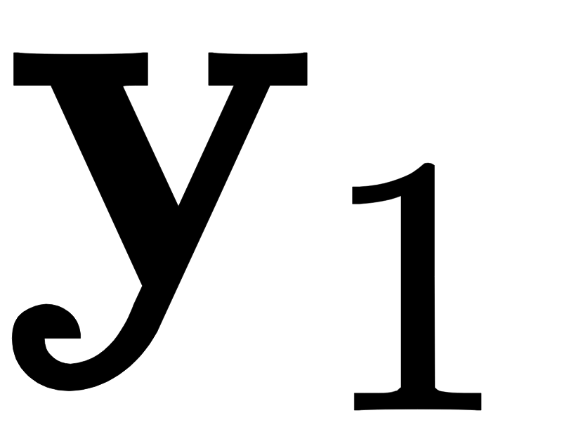
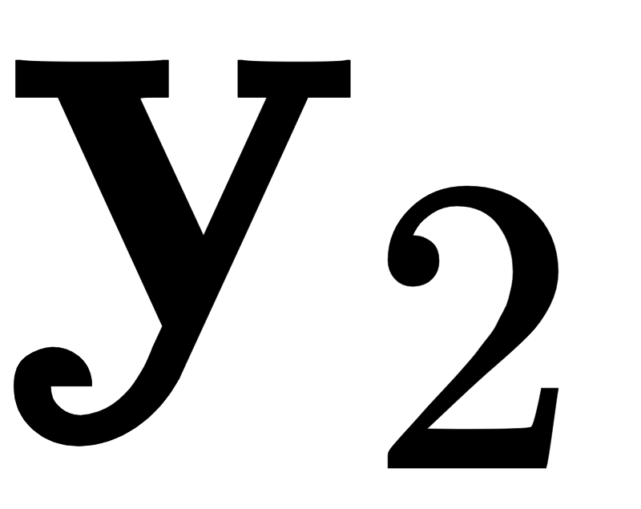
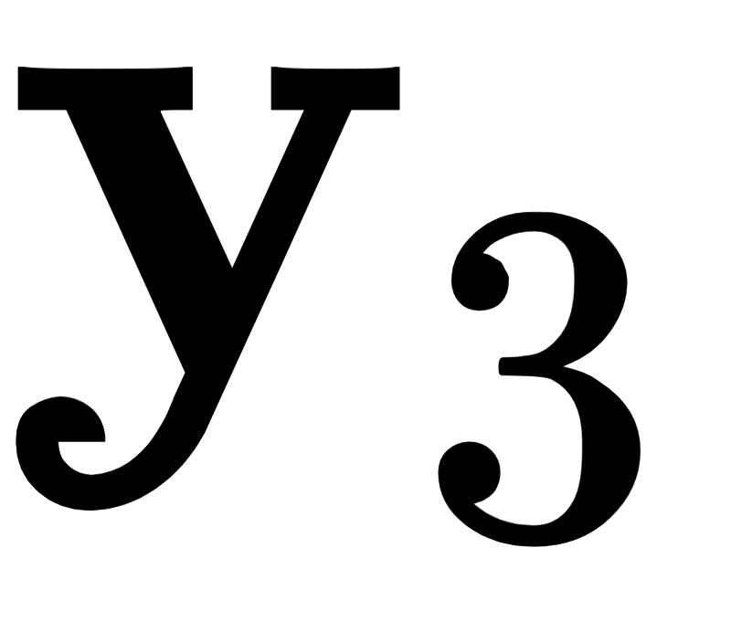
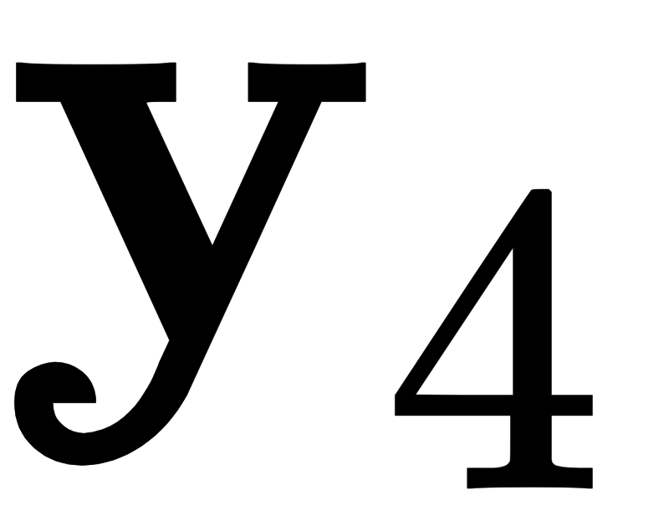
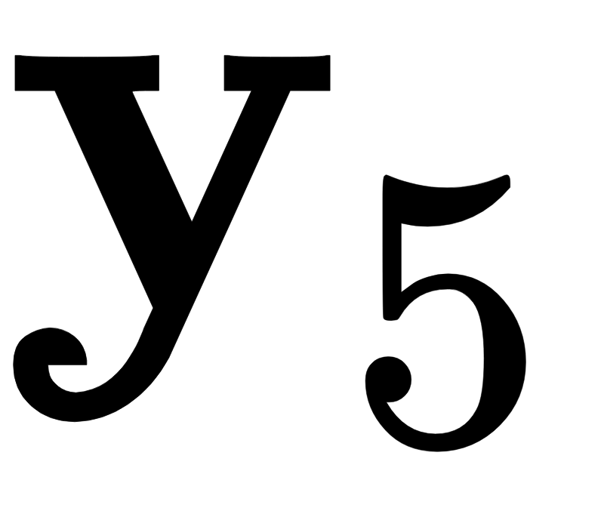
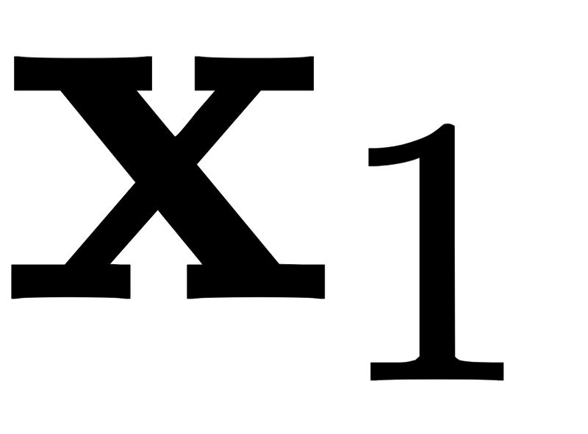
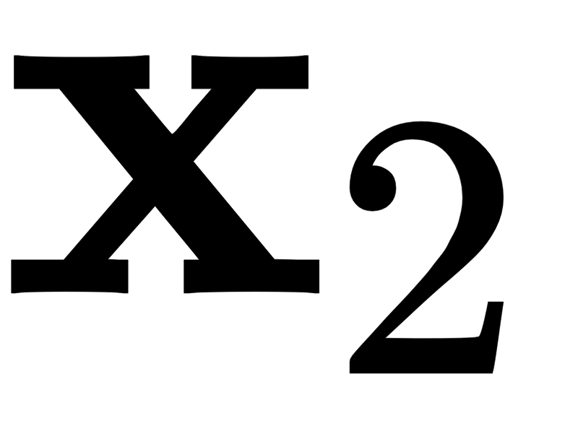
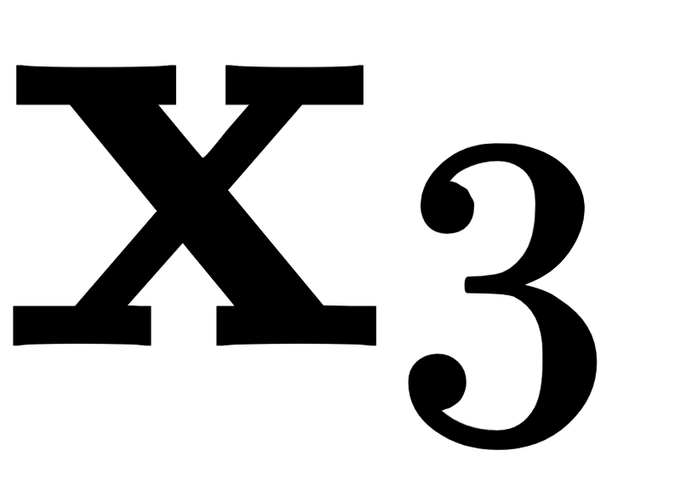
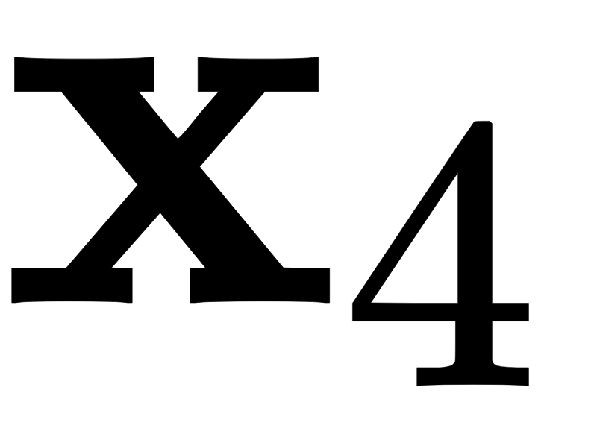


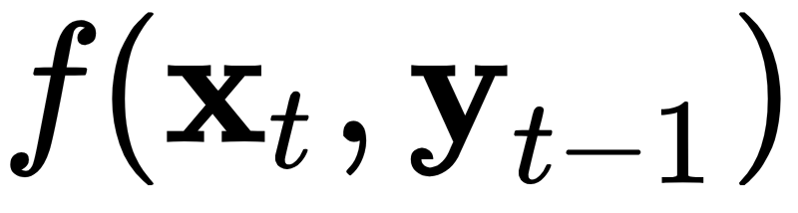
Recurrent Neural Network Layers
Idea: text as sequence
Prominent types: LSTM, GRU
Inductive bias: Recency
more recent symbols have bigger impact on hidden state
Advantages
everything is connected
easy to train and robust in practice
Disadvantages
Slow → computation time linear in length of text
not good for (very) long range dependencies
Good for: sentences, small paragraphs
move
from
Gospić
to
Prague
Tree-variants:
TreeLSTM (Tai et al., SCL’15)
RNN Grammars (Dyer et al. NAACL’16)
Bias towards syntactic hierarchy

Slide 64
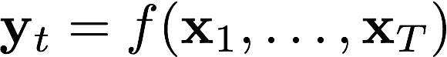
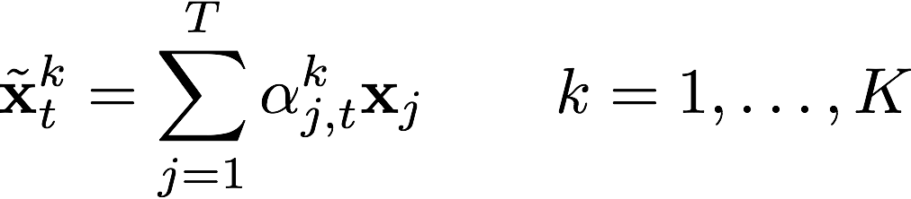
Self-Attention Layer
Idea: latent graph on text
Inductive bias:
relationships between word pairs
compute K separate weighted word representation(s) of the context for each word t
Advantages
can capture long-range dependencies
Parallelizable and fast
Disadvantages
careful setup of hyper-parameters
potentially memory intensive computation of attention weights for large contexts, O(T * T * K)
Good for: phrases, sentences, paragraphs
move
from
Gospić
to
Prague
Notes:
- The new kid on the block!

Slide 65
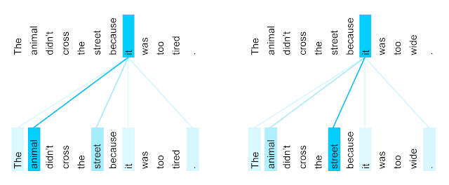
Self-Attention Layer
Graph with weighted edges of K types
Can capture:
coreference chains
syntactic dependency structure in text
Transformer Self-Attention Coreference Visualization https://ai.googleblog.com/2017/08/transformer-novel-neural-network.html
Notes:
Connection with Winograd schemas

Slide 66
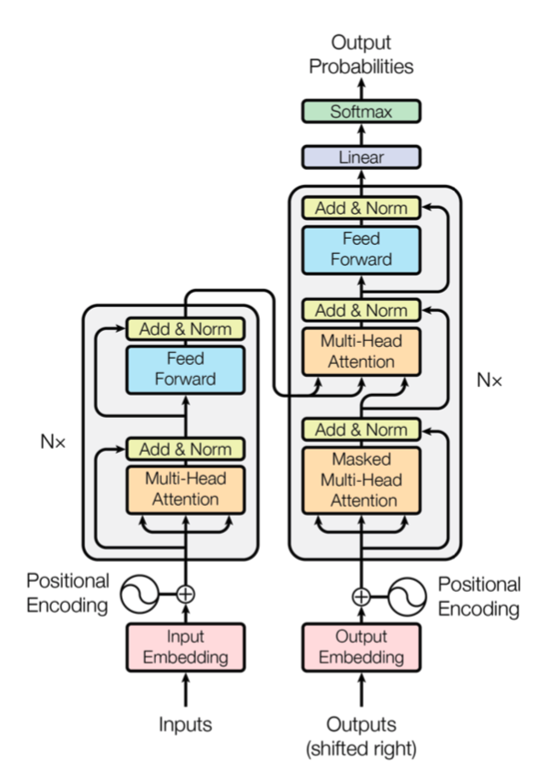
Transformer
Vaswani et al., NIPS’17
Residual connections before and after multi-head attention
Decoder uses both self attention and encoder attention
Figure from Vaswani et al., NIPS’17

Slide 67
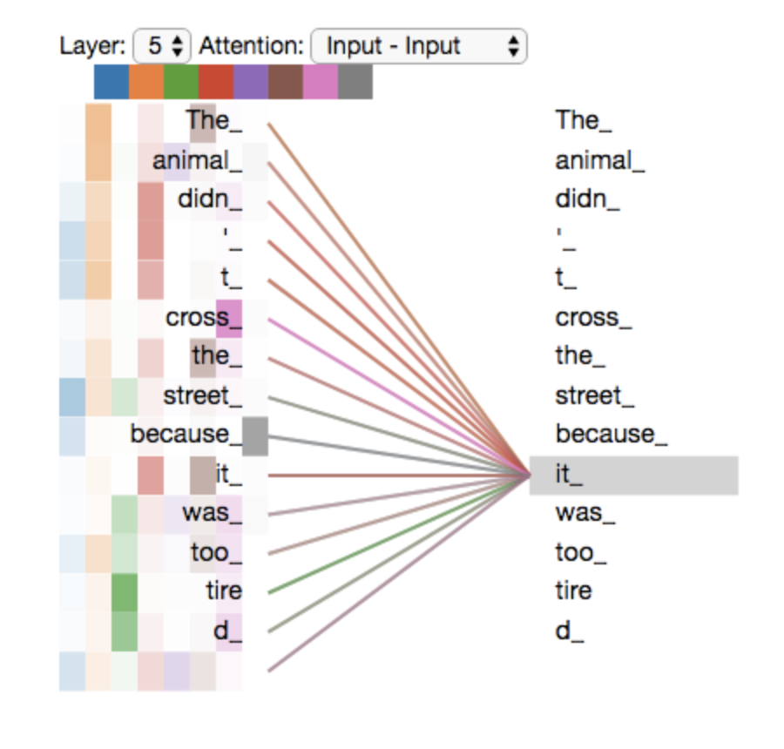
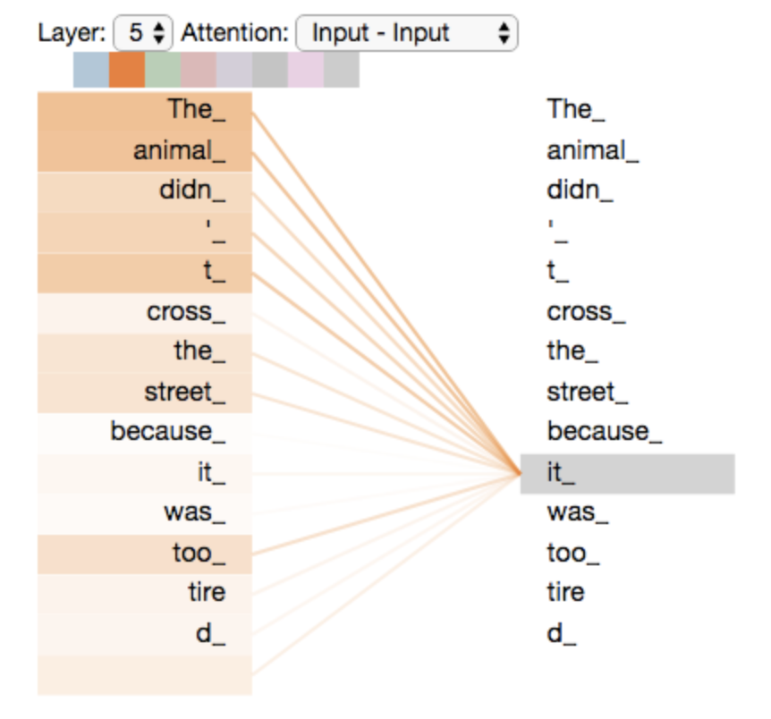
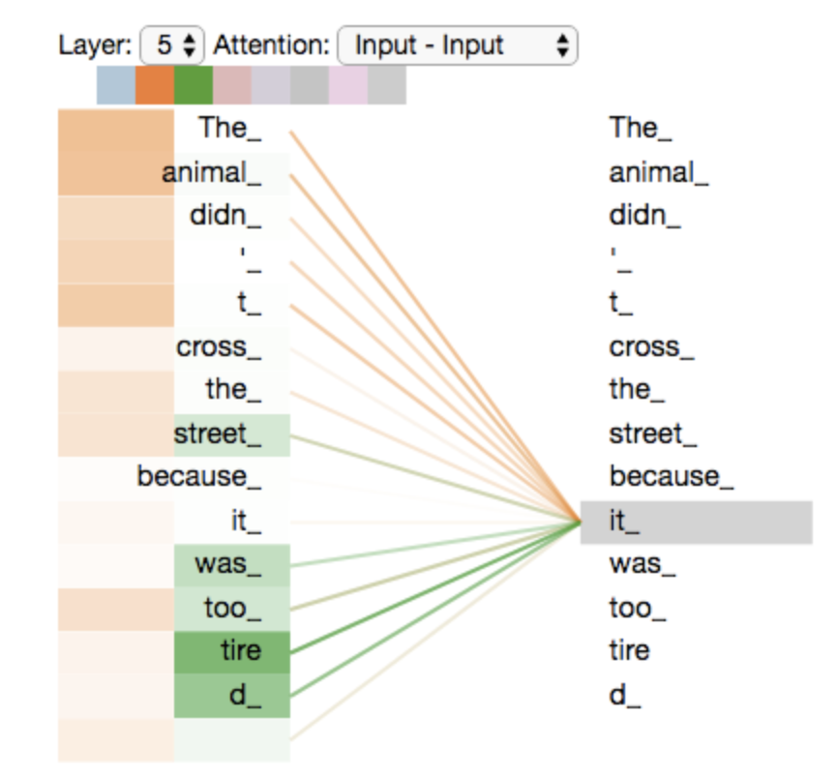
Multi-head attention
Figures from http://jalammar.github.io/illustrated-transformer/

Slide 68
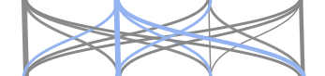
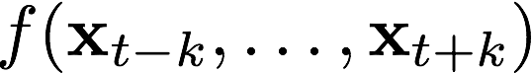
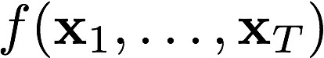
Compositional Sequence Encoders - Overview
Language is compositional!
Characters → Words → Phrases → Clauses → Sentences → Paragraphs → Documents
Architecture | RNN (LSTM, GRU) | CNN | Self-Attention
Illustration
Function
Advantages | - unlimited context - recency bias | - parallelizable → fast - local n-gram patterns | - parallelizable → fast - long-range dep
Disadvantages | - slower - strong recency bias - long-range dep | - limited context - strong locality bias - long-range dep | - harder to train - careful setup of hyper-parameters

Slide 69
The Attentive Reader Model: Overview
answer
Sequence Interaction:
Matching text with question
Composition: incorporating context around words
Input: Representing symbols as vectors
Precipitation
forms
as
smaller
How
do
water
Modified visualization from Hermann et. al. NIPS’15
Notes:
Say that we model symbols by one-hot vectors. We embed by a linear projection to much lower dimensionality → solves the aformentioned problem of high-dimensional feature spaces, however, such models have at least 1 hidden layer, no linear models anymore → backpropagation and DL to the rescue.
Projection matrix is often called the embedding matrix. Talk about word embeddings, and or character embeddings.

Slide 70
Modelling sequence interactions
Why? QA requires matching between question and text.
condition text representation on question (and vice versa)
“Naive approach”: concatenation
append question after text, use RNN with longer sequence
Problem with naive approach:
Long range dependencies: Many recurrent steps between answer and question → dilution of signal

Slide 71
Modelling sequence interactions
Combination of question and text representation
answer
attention-weighted sum of contextualised word representations
Precipitation
forms
as
smaller
How
do
water
Modified visualization from Hermann et. al. NIPS’15
Notes:
Say that we model symbols by one-hot vectors. We embed by a linear projection to much lower dimensionality → solves the aformentioned problem of high-dimensional feature spaces, however, such models have at least 1 hidden layer, no linear models anymore → backpropagation and DL to the rescue.
Projection matrix is often called the embedding matrix. Talk about word embeddings, and or character embeddings.

Slide 72
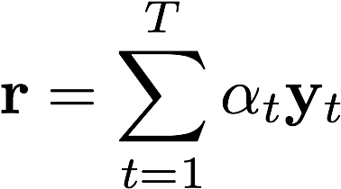



Modelling sequence interactions: Attention
Attention: relevance-weighted pooling of vectors across sequence
Attention mask computed can be conditional on question and text
Determines relevance of tokens for answering the question
Sequence aggregate
Contextual representations
… “move from Gospić to Prague ...

Slide 73

Modelling sequence interactions: Memory Networks
Sukhbaatar et al., NIPS’15 / Miller et al., EMNLP’16
Representation of the question + story
Where is the milk?
hallway
(m₁, m₂, m₃, m₄, …)
(m₁, m₂, m₃, m₄, …)
John
Memories
John dropped the milk.
John took the milk there.
Sandra went to the bathroom.
John moved to the hallway.
Mary went back to the bedroom.
Memories
m1: John dropped the milk.
m2: John took the milk there.
m4: John moved to the hallway.
m5: Mary went back to the bedroom.
m3: Sandra went to the bathroom.

Slide 74
Example: Learned attention patterns
End-to-end Memory Networks on bAbI tasks
Visualization from Sukhbaatar et. al., NIPS’15

Slide 75

Example: Learned attention patterns
Memory Networks on Children Book Test dataset
Visualization from Hill et. al., ICLR’16

Slide 76

Example: Learned attention patterns
Attentive Reader on QACNN/DailyMail dataset
Visualization from Hermann et. al. NIPS’15

Slide 77
The Attentive Reader Model: Overview
Answer Selection: answer prediction
answer
Sequence Interaction:
Matching text with question
Composition: incorporating context around words
Input: Representing symbols as vectors
Precipitation
forms
as
smaller
How
do
water
Modified visualization from Hermann et. al. NIPS’15
Notes:
Say that we model symbols by one-hot vectors. We embed by a linear projection to much lower dimensionality → solves the aformentioned problem of high-dimensional feature spaces, however, such models have at least 1 hidden layer, no linear models anymore → backpropagation and DL to the rescue.
Projection matrix is often called the embedding matrix. Talk about word embeddings, and or character embeddings.

Slide 78
Answer prediction
Usually linear projection
Probability distribution over different answer options
Multiple choices: candidates (as in bAbI)
Spans in text -- distribution over positions for beginning and end (as in SQuAD)
Training:
Cross-entropy loss
Ranking loss

Slide 79
Answer selection: Ranking (Memory Networks)
Sukhbaatar et al., NIPS’15 / Miller et al., EMNLP’16
Where is the milk?
hallway
John
(m₁, m₂, m₃, m₄, …)
milk
(m₁, m₂, m₃, m₄, …)
John
Memories
John dropped the milk.
John took the milk there.
Sandra went to the bathroom.
John moved to the hallway.
Mary went back to the bedroom.
Memories
hallway
m1: John dropped the milk.
m2: John took the milk there.
m4: John moved to the hallway.
m5: Mary went back to the bedroom.
m3: Sandra went to the bathroom.
office
…

Slide 80
The Attentive Reader Model: Overview
Answer Selection: answer prediction
answer
Sequence Interaction:
Matching text with question
Composition: incorporating context around words
Input: Representing symbols as vectors
Precipitation
forms
as
smaller
How
do
water
Modified visualization from Hermann et. al. NIPS’15
Notes:
Say that we model symbols by one-hot vectors. We embed by a linear projection to much lower dimensionality → solves the aformentioned problem of high-dimensional feature spaces, however, such models have at least 1 hidden layer, no linear models anymore → backpropagation and DL to the rescue.
Projection matrix is often called the embedding matrix. Talk about word embeddings, and or character embeddings.

Slide 81
Conclusion
We gathered all ingredients to build state-of-the-art supervised Machine Reading systems!
architectures work well in practice ... as long as we stay in-domain and questions are simple
We covered only extractive and multiple choice questions settings but there is also generative machine reading
Practice in Labs tomorrow on bAbI!

Slide 82
References Compositional Sequence Encoders
Peters, M. E., Neumann, M., Iyyer, M., Gardner, M., Clark, C., Lee, K., & Zettlemoyer, L. (2018). Deep contextualized word representations. NAACL.
McCann, B., Bradbury, J., Xiong, C., & Socher, R. (2017). Learned in translation: Contextualized word vectors. NIPS.
Radford, A., Narasimhan, K., Salimans, T., & Sutskever, I. (2018). Improving Language Understanding by Generative Pre-Training. arXiv.
Howard, J. & Ruder, S. (2018). Universal Language Model Fine-tuning for Text Classification. ACL.
Vaswani, A., Shazeer, N., Parmar, N., Uszkoreit, J., Jones, L., Gomez, A. N., Kaiser, Ł. & Polosukhin, I. (2017). Attention is all you need. NIPS.
Cheng, J., Dong, L., & Lapata, M. (2016). Long short-term memory-networks for machine reading. EMNLP.
Wang, W., Yang, N., Wei, F., Chang, B., & Zhou, M. (2017). Gated self-matching networks for reading comprehension and question answering. ACL.
Yu, A. W., Dohan, D., Luong, M. T., Zhao, R., Chen, K., Norouzi, M., & Le, Q. V. (2018). QANet: Combining Local Convolution with Global Self-Attention for Reading Comprehension. ICLR.
Yang, Z., Zhao, J., Dhingra, B., He, K., Cohen, W. W., Salakhutdinov, R., & LeCun, Y. (2018). GLoMo: Unsupervisedly Learned Relational Graphs as Transferable Representations. arXiv.
Tai, K. S., Socher, R., & Manning, C. D. (2015). Improved semantic representations from tree-structured long short-term memory networks. ACL.
Dyer, C., Kuncoro, A., Ballesteros, M., & Smith, N. A. (2016). Recurrent Neural Network Grammars. NAACL.

Slide 83
References Interaction
Cho, K., Gulcehre, B. V. M. C., Bahdanau, D., Schwenk, F. B. H., & Bengio, Y. (2014). Learning Phrase Representations using RNN Encoder–Decoder for Statistical Machine Translation. EMNLP.
Sutskever, I., Vinyals, O., & Le, Q. V. (2014). Sequence to sequence learning with neural networks. NIPS.
Bahdanau, D., Cho, K., & Bengio, Y. (2015). Neural machine translation by jointly learning to align and translate. ICLR.
Sukhbaatar, S., Weston, J., & Fergus, R. (2015). End-to-end memory networks. NIPS.
Kumar, A., Irsoy, O., Ondruska, P., Iyyer, M., Bradbury, J., Gulrajani, I., ... & Socher, R. (2016). Ask me anything: Dynamic memory networks for natural language processing. ICML.
Graves, A., Wayne, G., Reynolds, M., Harley, T., Danihelka, I., Grabska-Barwińska, A., ... & Badia, A. P. (2016). Hybrid computing using a neural network with dynamic external memory. Nature
Grefenstette, E., Hermann, K. M., Suleyman, M., & Blunsom, P. (2015). NIPS.
Henaff, M., Weston, J., Szlam, A., Bordes, A., & LeCun, Y. (2017). Tracking the world state with recurrent entity networks. ICLR.
Rocktäschel, T., Grefenstette, E., Hermann, K. M., Kočiský, T., & Blunsom, P. (2016). Reasoning about entailment with neural attention. ICLR.
Yu, A. W., Dohan, D., Luong, M. T., Zhao, R., Chen, K., Norouzi, M., & Le, Q. V. (2018). QANet: Combining Local Convolution with Global Self-Attention for Reading Comprehension. ICLR.

Slide 84
References
Adversarial Examples for Evaluating Reading Comprehension Systems (Jia et al. 2017, EMNLP)
Know What You Don’t Know: Unanswerable Questions for SQuAD (Rajpurkar et al. 2018, ACL)
Visual question answering: Datasets, algorithms, and future challenges (Kafle et al. 2017, Computer Vision and Image Understanding)
Making the V in VQA Matter: Elevating the Role of Image Understanding in Visual Question Answering (Goyal et al. 2017, CVPR)
Reading Wikipedia to Answer Open-Domain Questions (Chen et al. 2017, ACL)
Event2Mind: Commonsense Inference on Events, Intents, and Reactions (Rashkin et al. 2018, arXiv)
Semantically Equivalent Adversarial Rules for Debugging NLP Models (Ribeiro 2018, ACL)
Understanding Neural Networks through Representation Erasure (Li et al. 2016, arXiv)
HotFLip: White-Box Adversarial Examples for NLP (Ebrahimi et al. 2017, arXiv)
Anchors: High-Precision Model-Agnostic Explanations (Ribeiro et al. 2018, AAAI)
Deep contextualized word representations (Peters et al. 2018, NAACL)
Learned in Translation: Contextualized Word Vectors (McCann et al. 2017, NIPS)
Supervised Learning of Universal Sentence Representations from Natural Language Inference Data (Conneau et al. 2017, EMNLP)
Efficient Estimation of Word Representations in Vector Space (Mikolov et al. 2013, NIPS)
Simple and Effective Semi-Supervised Question Answering (Dhingra et al. NAACL 2018)
Neural Domain Adaptation for Biomedical Question Answering (Wiese et al. 2017, CoNLL)
Improving Language Understanding by Generative Pre-Training (Radford et al. 2018, arXiv)
Neural Skill Transfer from Supervised Language Tasks to Reading Comprehension (Mihaylov et al. 2017, arXiv)
Representing General Relational Knowledge in ConceptNet 5 (Speer and Havasi, LREC 2012)
Learning to understand phrases by embedding the dictionary (Hill et al. 2016, TACL)
Leveraging knowledge bases in lstms for improving machine reading (Yang et al. 2017, ACL)
Knowledgeable Reader: Enhancing Cloze-Style Reading Comprehension with External Commonsense Knowledge. (Mihaylov and Frank, 2018, ACL)
Reading Wikipedia to Answer Open-Domain Questions (Chen et al. 2017, ACL)
Evidence aggregation for answer re-ranking in open-domain question answering (Wang et al. ICLR 2018)
Marco Baroni and Gemma Boleda: https://www.cs.utexas.edu/~mooney/cs388/slides/dist-sem-intro-NLP-class-UT.pdf
News article: https://www.independent.co.uk/infact/brexit-second-referendum-false-claims-eu-referendum-campaign-lies-fake-news-a8113381.html

Slide 85
References for Datasets
Building a question answering test collection, Voorhees & Tice SIGIR 2000
Besting the Quiz Master: Crowdsourcing Incremental Classification Games, Boyd-Graber et al. EMNLP 2012
Semantic Parsing on Freebase from Question-Answer Pairs, Berant et al. EMNLP 2013
Mctest: A challenge dataset for the open-domain macchine comprehension of text, Richardson et al. EMNLP 2013
Teaching Machines to Read and Comprehend, Hermann et al. NIPS 2015
WikiQA: A challenge dataset for open-domain question answering, Yang et al. EMNLP 2015
Large-scale Simple Question Answering with Memory Networks, Bordes et al. 2015 arXiv:1506.02075.
The Goldilocks Principle: Reading Children’s Books with Explicit Memory Representations, Hill et al. ICLR 2016
SQuAD: 100,000+ Questions for Machine Comprehension of Text, Rajpurkar et al. EMNLP 2016
[SQuAD 2.0] Know What You Don't Know: Unanswerable Questions for SQuAD, Rajpurkar and Jia et al. ACL 2018
Towards AI-Complete Question Answering: A Set of Prerequisite Toy Tasks, Weston et al. ICLR 2016
Constraint-Based Question Answering with Knowledge Graph, Bao et al. COLING 2016
MovieQA: Understanding Stories in Movies through Question-Answering, Tapawasi et al. CVPR 2016
Who did What: A Large-Scale Person-Centered Cloze Dataset, Onishi et al. EMNLP 2016
MS MARCO: A Human Generated MAchine Reading COmprehension Dataset, Nguyen et al. NIPS 2016
The LAMBADA dataset: Word prediction requiring a broad discourse context, Paperno et al. ACL 2016
WIKIREADING: A Novel Large-scale Language Understanding Task over Wikipedia, Hewlett et al. ACL 2016
TriviaQA: A Large Scale Distantly Supervised Challenge Dataset for Reading Comprehension, Joshi et al. ACL 2017
Crowdsourcing Multiple Choice Science Questions, Welbl et al. WNUT 2017
RACE: Large-scale ReAding Comprehension Dataset From Examinations, Lai et al. EMNLP 2017
NewsQA: a Machine Comprehension Dataset, Trischler et al. RepL4NLP 2017
Science Exam Datasets by the Allen Institute for Artificial Intelligence: https://allenai.org/data/data-all.html
SearchQA: A New Q&A Dataset Augmented with Context from a Search Engine, Dunn et al. https://arxiv.org/pdf/1704.05179.pdf
Quasar: Datasets for Question Answering by Search and Reading. Dhingra et al. 2017 https://arxiv.org/abs/1707.03904
Constructing Datasets for Multi-Hop Reading Comprehension across Documents, Welbl et al. TACL 2018
The NarrativeQA Reading Comprehension Challenge, Kocisky et al. TACL 2018

